Slide 1
Microsoft OneDrive Tips
GIS Academy

Slide 2



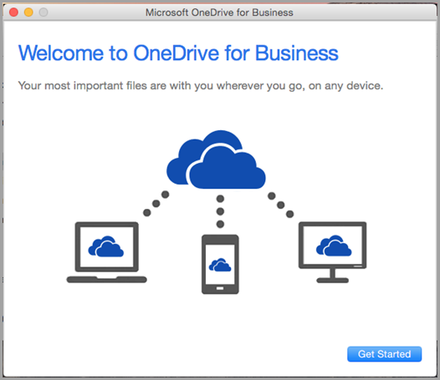

OneDrive Knowledge Sharing
Saving Files
Syncing Files
Share and Collaborate in real time
Version History
Access Files by Company Mobile OneDrive
Sharing
Collaboration
2

Slide 3
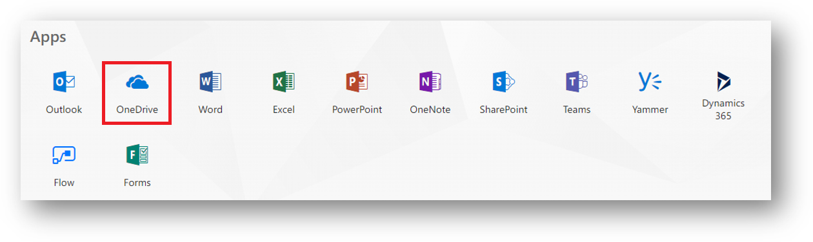
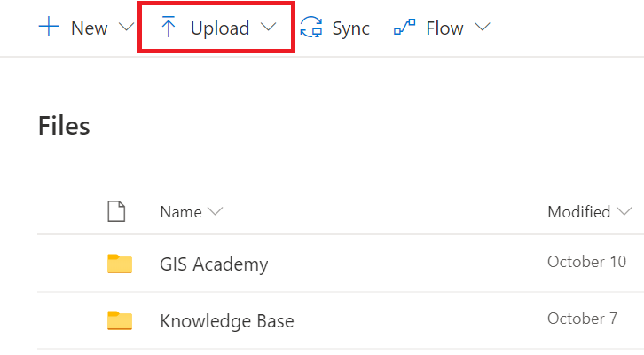
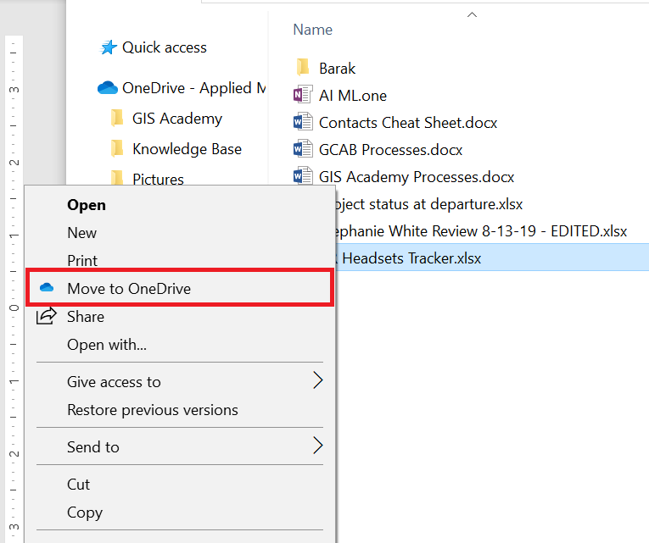

Saving Files
Method 1:
Go to office.com
Select OneDrive from the O365 Portal.
Once OneDrive online has been launched select Upload.
Method 2:
Go to the file location of the document you want to upload to OneDrive --> right click it --> select Move to OneDrive.
Your chosen file will then populate to the list of documents on you OneDrive.

Slide 4
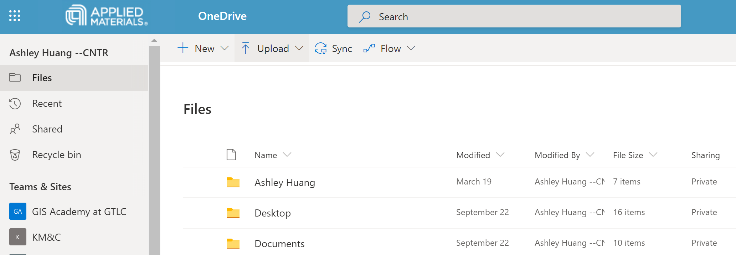
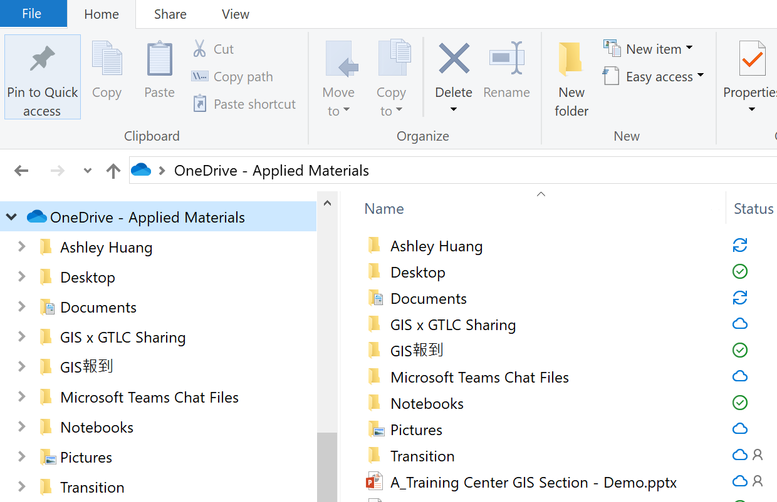
Syncing Files
1
2
Files Syncing
Open OneDrive on your webpage
Click Sync
Open OneDrive-Applied Materials to see all the changes

Slide 5



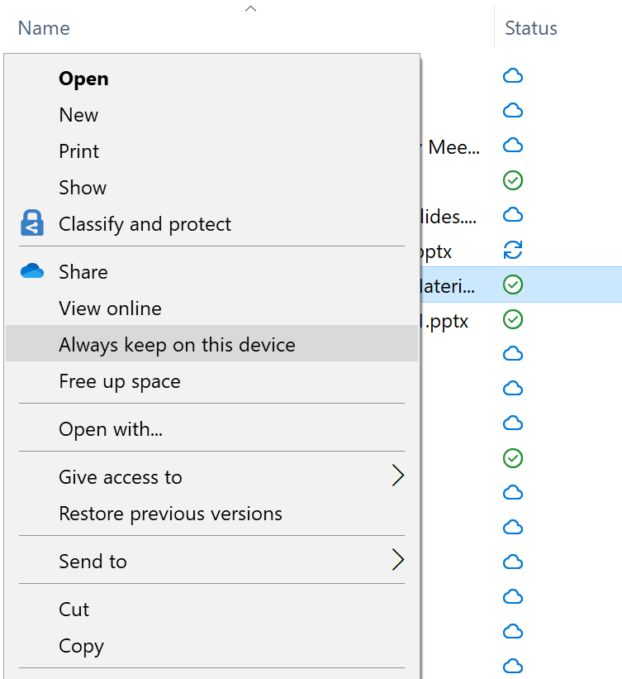
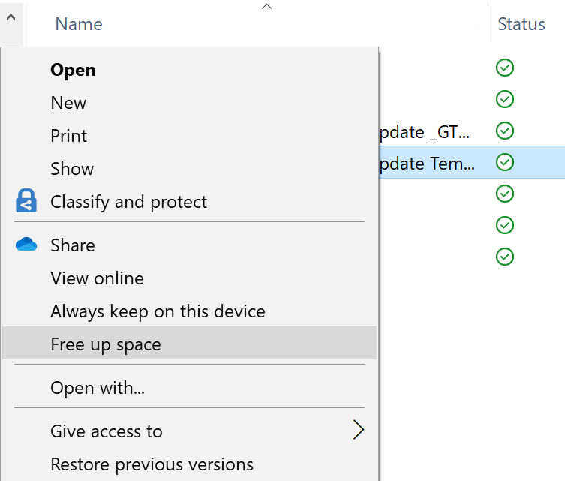
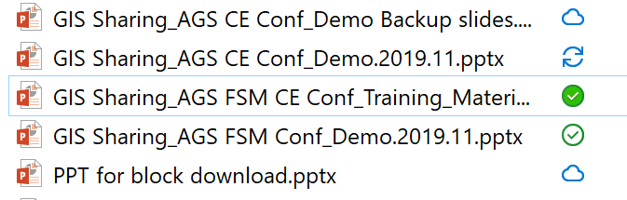
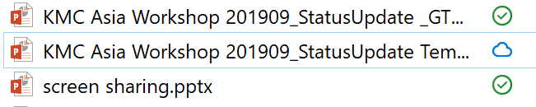
Syncing Files
File exists on cloud only
File exists on cloud and my local PC but it could be changed to cloud only by the system
File exists on cloud and my local PC forever until I change the option by manual
Working in progress downloading or uploading the file between PC and cloud
Always keep on this device
Free up the space
1
1
Right click
2
Right click
2

Slide 6
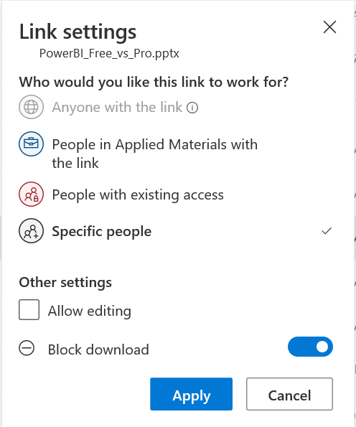
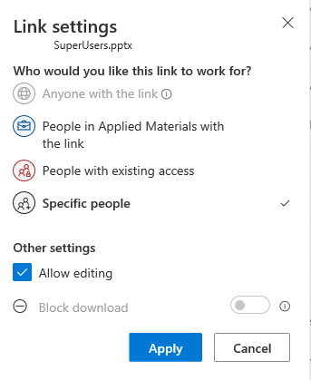
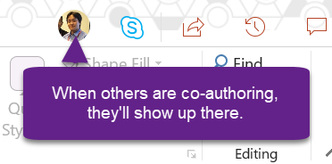
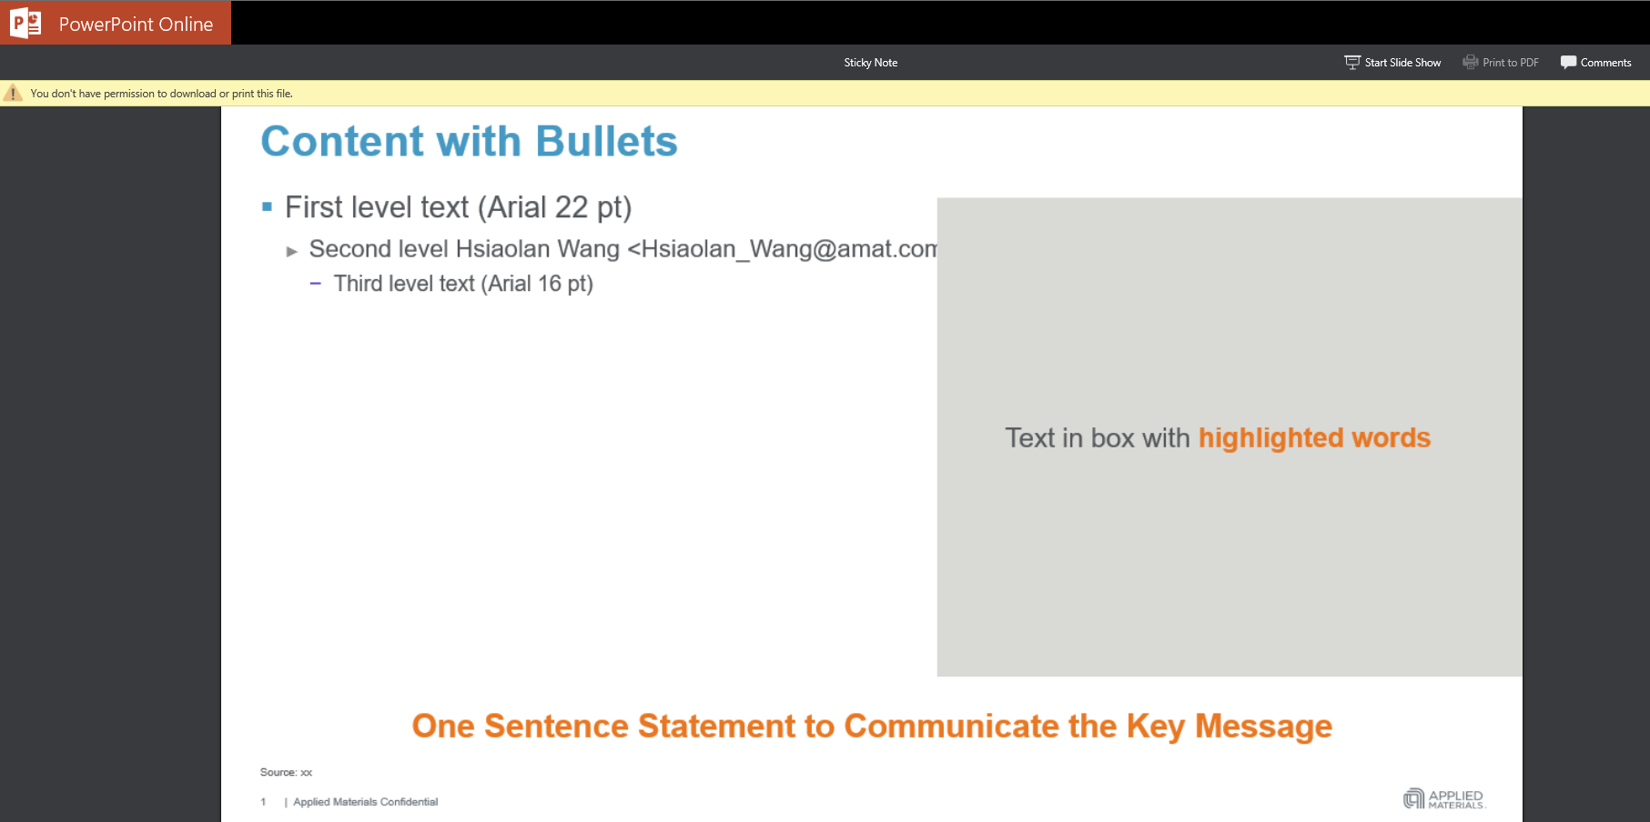
Share and Collaborate in real time
Share and Collaborate in real time
Select the file or folder you want to share -> Select Share -> Enter a name or email address -> Click the dropdown list to change the type of link -> enable Allow editing -> click Apply
Tips: Block Download
Same way to share, but only Read only -> Enable Block Download

Slide 7
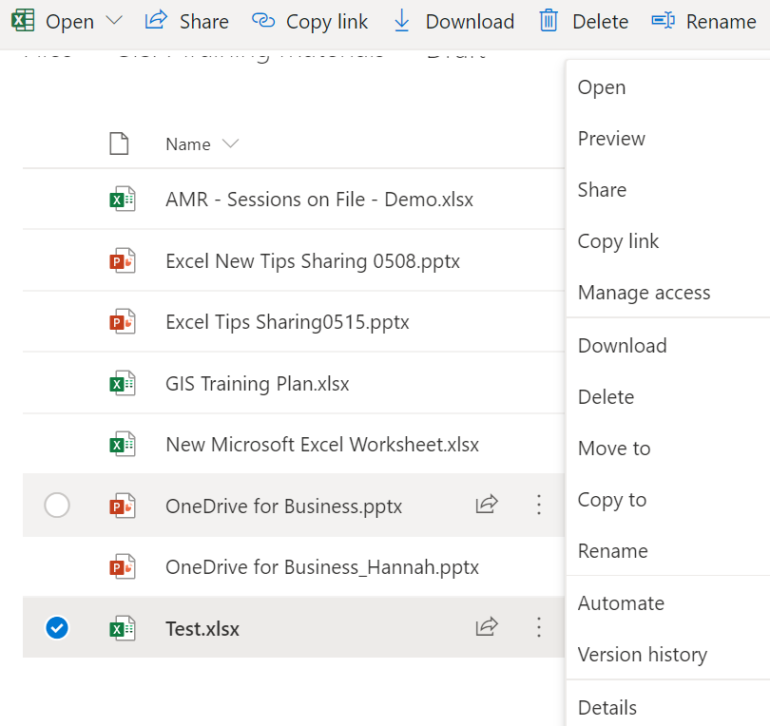
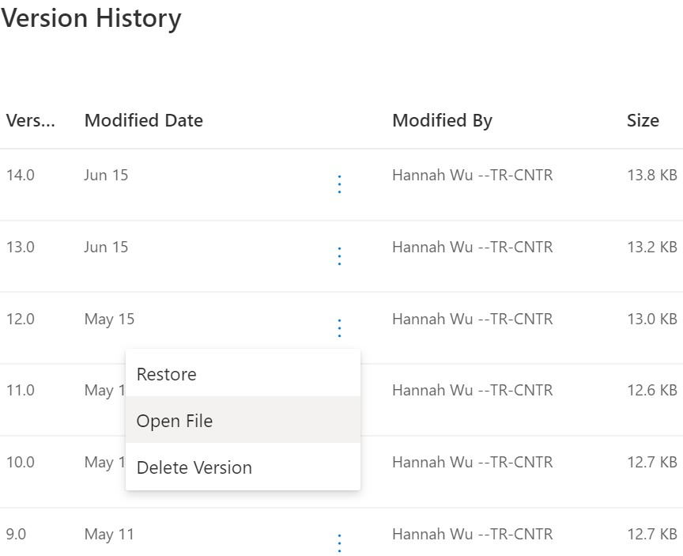
OneDrive Tips – Version History
Open OneDrive through your Webpage
Select the target file --> Click
Select Version history
Click to Restore/ Open File / Delete Version
Version History helps you find out
the best version you ever created.
4
1
2
3

Slide 8
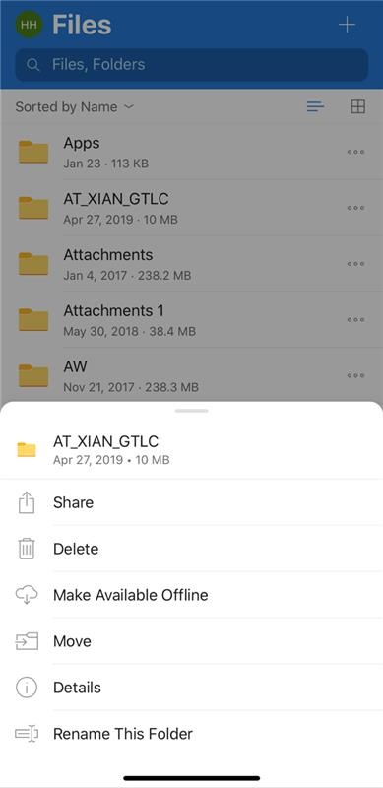

Access Files by Company Mobile OneDrive
With OneDrive mobile app. You can easily upload, preview, edit and co-author, share, delete and recover files.
Make files or folders "offline" to access them anytime anywhere, even without Internet.
1
2

Slide 9



Scan QR Code
Class ID 70243
For more new tips, come to GIS Academy in your regions
Http://GIS Academy
Help needed please call *5 or Http://help, for other training materials please visit our knowledge Base

